Slide 1









My Number Interactive Notebook
$$×$$
$$\frac{1}{2}$$
$$÷$$
$$+$$
$$−$$
$$\frac{3}{5}$$
$$7$$
Name
Class
Teacher
Term 1 Semester 1
$$5^{2}$$
$$\sqrt{9}$$
1

Slide 2
Create your own front page
It needs to contain the following –
My number interactive notebook
Name
Class
Teachers Name
Semester 1 Term 1
Page number 1

Slide 3
Contents
Glossary or Formula Page
Page
Date
Description
2
3

Slide 4
Tasks
24
7
30
Essential Question
Questions
Notes
Summary
4
5

Slide 5
24
7
30
Date
Ratio
EQ – Why do we use ratios and what are they used for?

Slide 6
24
7
30
Date
Ratio
EQ – Why do we use ratios and what are they used for?
What is a ratio?
Ratios are used to compare quantities with the same units.

Slide 7
24
7
30
Date
Ratio
EQ – Why do we use ratios and what are they used for?
What is a ratio?
Ratios are used to compare quantities with the same units.
The ratio of 2 to 5 is written as 2 : 5

Slide 8
24
7
30
Date
Ratio
EQ – Why do we use ratios and what are they used for?
What is a ratio?
Ratios are used to compare quantities with the same units.
The ratio of 2 to 5 is written as 2 : 5
How do I simplify ratios?

Slide 9
24
7
30
Date
Ratio
EQ – Why do we use ratios and what are they used for?
What is a ratio?
Ratios are used to compare quantities with the same units.
The ratio of 2 to 5 is written as 2 : 5
Ratios in their simplest form use whole numbers with no common factors
How do I simplify ratios?

Slide 10
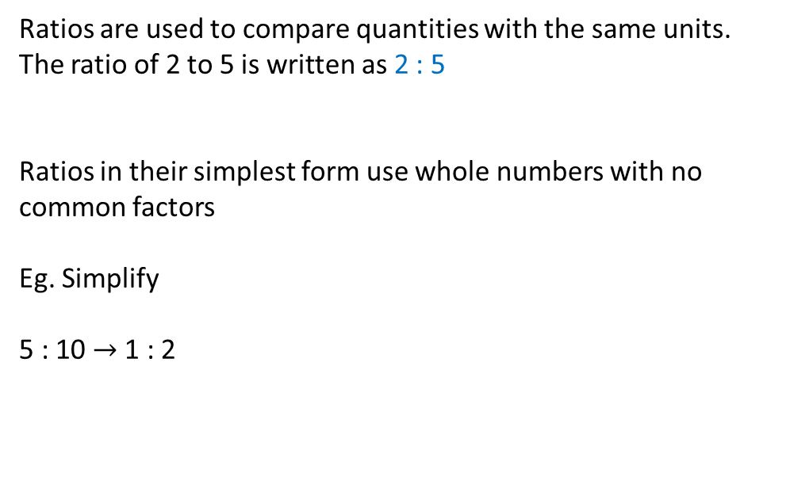
24
7
30
Date
Ratio
EQ – Why do we use ratios and what are they used for?
What is a ratio?
Ratios are used to compare quantities with the same units.
The ratio of 2 to 5 is written as 2 : 5
Ratios in their simplest form use whole numbers with no common factors
Eg. Simplify
5 : 10 $→$1 : 2
How do I simplify ratios?

Slide 11
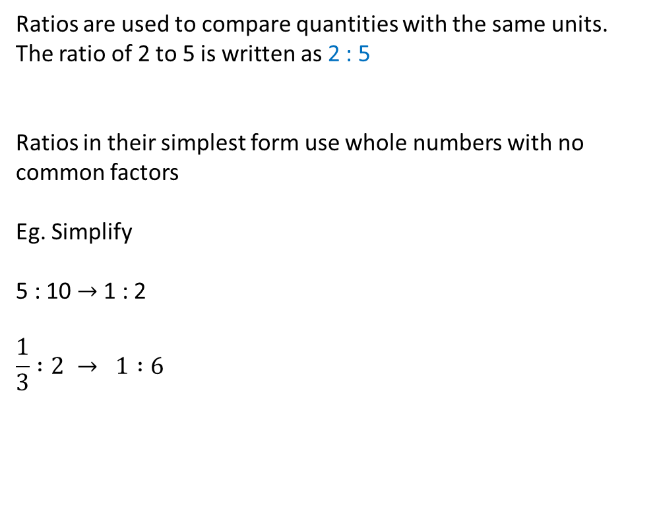
24
7
30
Date
Ratio
EQ – Why do we use ratios and what are they used for?
What is a ratio?
Ratios are used to compare quantities with the same units.
The ratio of 2 to 5 is written as 2 : 5
Ratios in their simplest form use whole numbers with no common factors
Eg. Simplify
5 : 10 $→$1 : 2
$$\frac{1}{3} :2 → 1 :6$$
How do I simplify ratios?

Slide 12
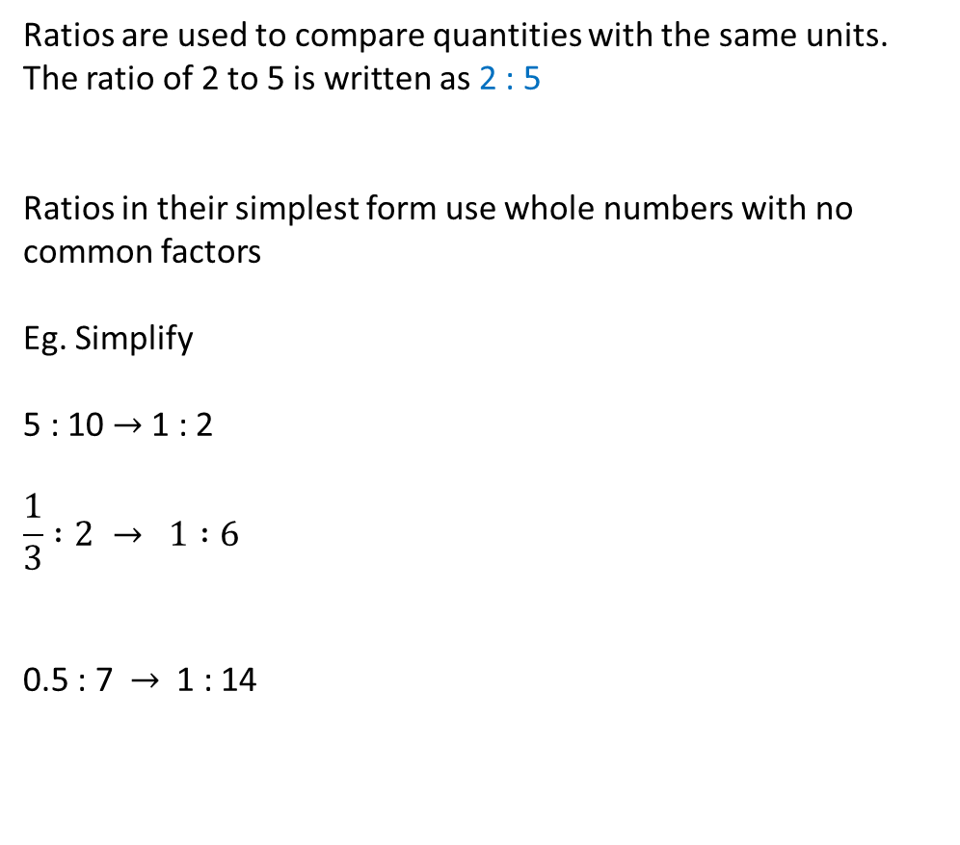
24
7
30
Date
Ratio
EQ – Why do we use ratios and what are they used for?
What is a ratio?
Ratios are used to compare quantities with the same units.
The ratio of 2 to 5 is written as 2 : 5
Ratios in their simplest form use whole numbers with no common factors
Eg. Simplify
5 : 10 $→$1 : 2
$$\frac{1}{3} :2 → 1 :6$$
0.5 : 7 $→$1 : 14
How do I simplify ratios?

Slide 13

24
7
30
Date
Ratio
EQ – Why do we use ratios and what are they used for?
What is a ratio?
Ratios are used to compare quantities with the same units.
The ratio of 2 to 5 is written as 2 : 5
Ratios in their simplest form use whole numbers with no common factors
Eg. Simplify
5 : 10 $→$1 : 2
$$\frac{1}{3} :2 → 1 :6$$
0.5 : 7 $→$1 : 14
1m : 30cm $→$ 100 : 30 $→$ 10 : 3
How do I simplify ratios?

Slide 14
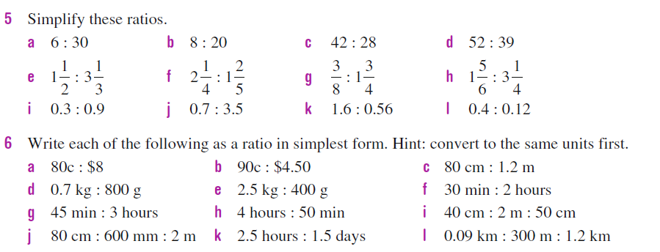

Slide 15
Notes Review
24, 7 ,30
Date
Title
Essential question
Notes complete
Notes complete with colour and diagrams
Questions completed
Contents page filed in
Formula page filled in

Slide 16
Homework
Review your notes and write a summary answering the essential question.

